Slide 1
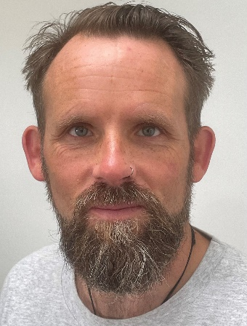
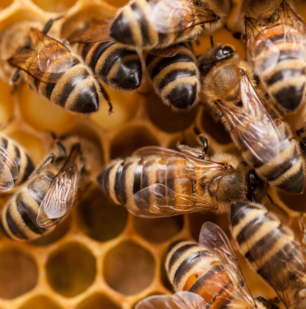
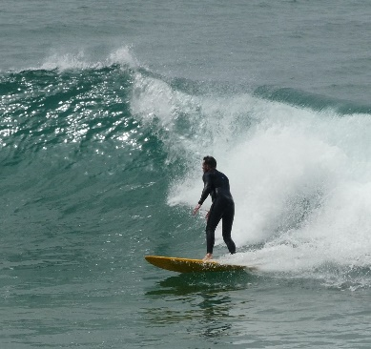
Hello!
My name is
Jon Evison
ADD PHOTO
from the NHS Mental Health Support Team (MHST) in Schools.
I am an Education Mental Health Practitioner (EMHP) and I work with children who might be feeling sad or worried, to try to help them feel better.
Here are some things about me:
ADD PHOTO OF HOBBIES
I am a keen Beekeeper
I have been working in Primary schools for the last ten years
ADD PHOTO OF HOBBIES
I love to travel with my family and find some Adventure.
I look forward to meeting you!
If you need to contact me, then you can contact your school's Designated Mental Health Lead (DMHL).
Your School Contact is:
Mrs Douglass / Mrs Read

