Slide 1

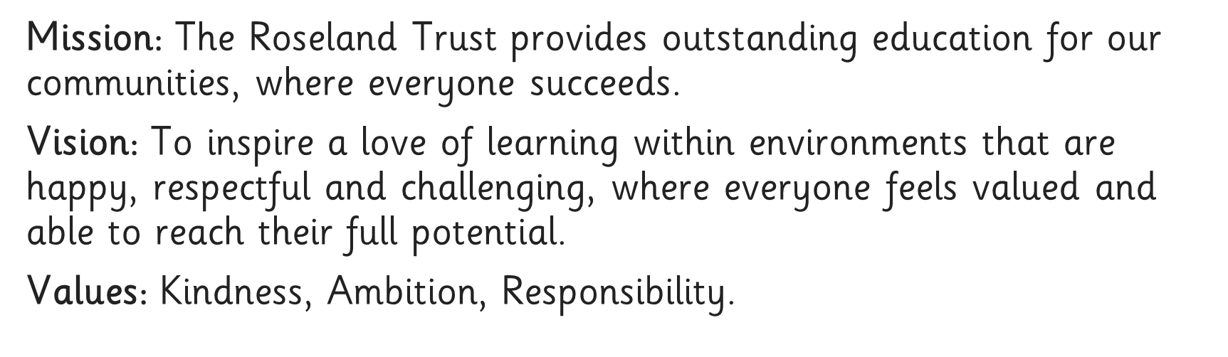





Slide 2


Slide 3
What is phonics?
Phonics - the sounds that our alphabet represent.
We have 26 letters, 44 sounds and 150+ ways of writing those sounds!
We need to make sure our children learn these sounds quickly and that they are embedded.

Slide 4
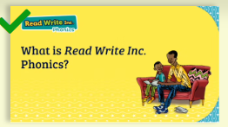
What is Read Write Inc?
https://schools.ruthmiskin.com/training/view/xpmQYFNS/4eCSXIV5
Notes:
All words are made up of individual sounds. These sounds are merged together to form words.
e.g. in ‘mat’ we have the sounds ‘m’, ‘a’, ‘t’, ship – ‘sh’, ‘i’, ‘p’.
Click A grapheme is another name for the letters we use to write the sound. The spelling of that sound on the page.
Phonics is the method of teaching reading through the identification of sounds and graphemes.
The new National Curriculum ensures that all children are taught Phonics systematically.
This gives your children the tools to read any word.

Slide 5
How is RWI organised?
Stage not age – children are grouped based on their reading level and regrouped regularly
Children are taught in groups according to their reading ability so, your child may be in a group with younger or older children. This will enable us to teach your child more effectively.

Slide 6
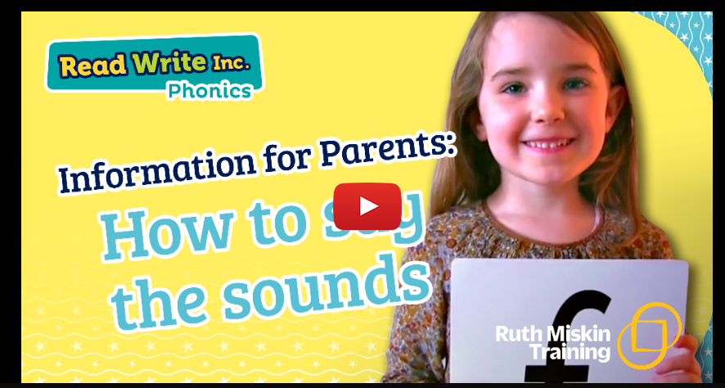
Speed Sounds
The sounds are split up into 3 sets.
There are BOUNCY sounds…
…and STRETCHY sounds!
It is vital that we teach our children to pronounce the sounds correctly.
We call these pure sounds.
https://schools.ruthmiskin.com/training/view/4GFkx6uU/KgUSx3BU

Slide 7
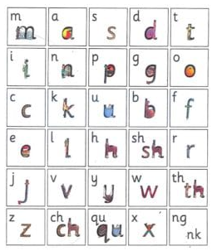
Notes:
Remember that:
- Children need to know sounds – not letter names – to read words.
- We pronounce the sounds clearly, using pure sounds (‘m’ not’ muh’, ’s’ not ‘suh’, etc.) so that your child will be able to blend the sounds together to make words more easily.

Slide 8
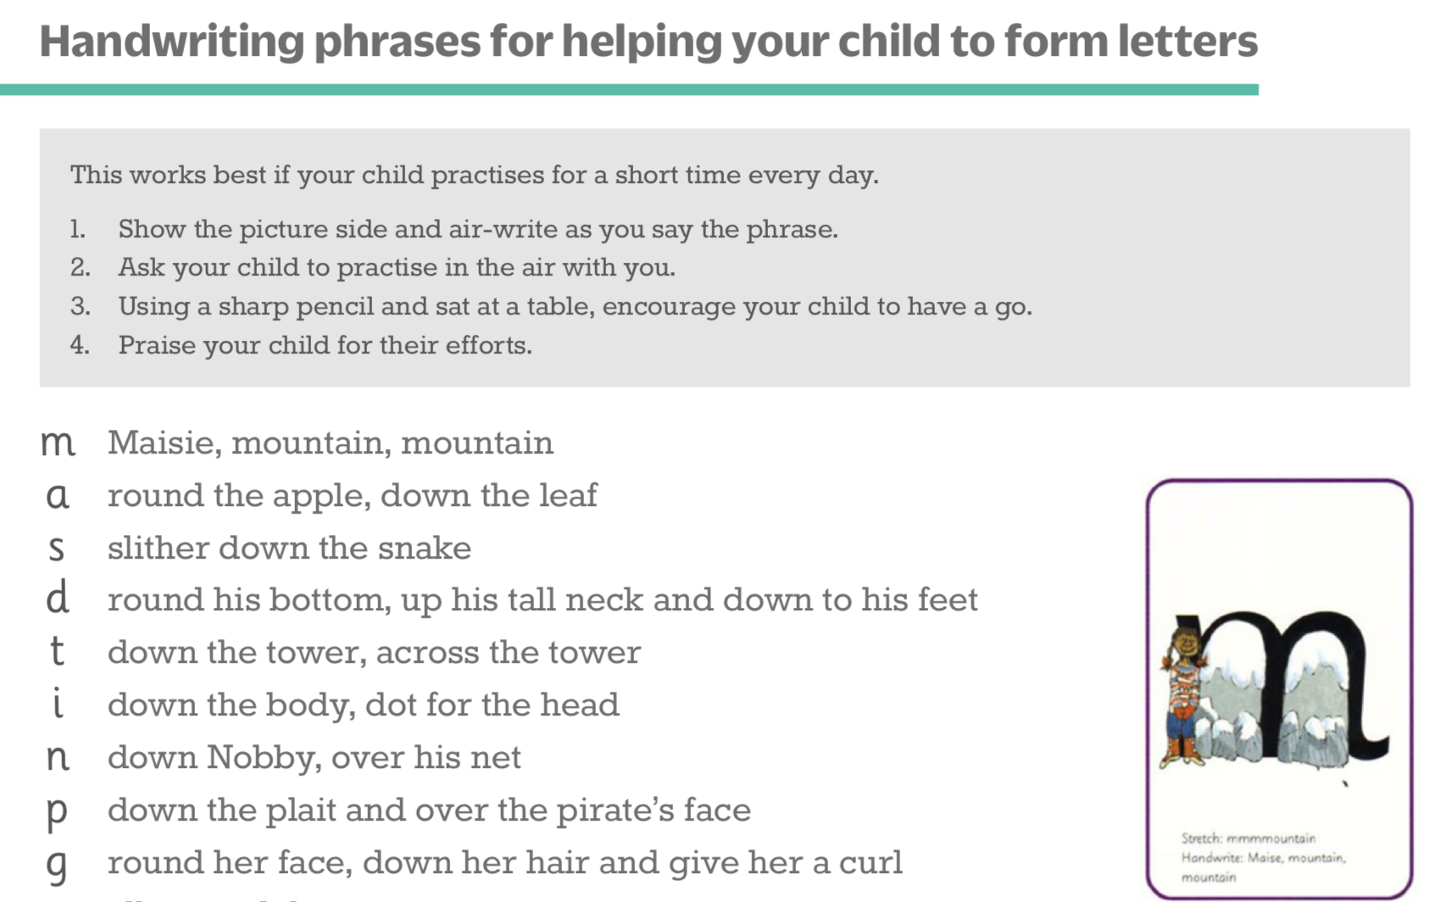
Teaching letter formation
Notes:
Children use the picture mnemonic to learn to form letters correctly at the same time they learn to read each sound.
Each sound has a handwriting phrase e.g. down Maisie, and over the mountains.
Use these handwriting phrases when practising writing at home with your child.
Avoid using these to read the sound.
I will give you a handout of these handwriting phrases when you leave today.

Slide 9
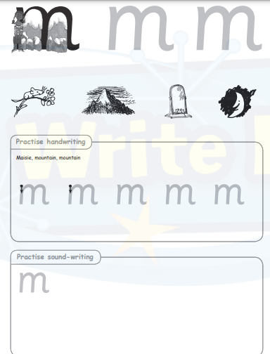
Notes:
In Reception, the children start their phonics lessons by learning a sound a day and practising their letter formation. They also have chance to revisit their previous learnt sounds to embed letterformation and rhymes.
At the end of each week, children will be sent home letter formation sheets so that you can pracitse these at home too. These letter formation sheets will also be found on the website under the phonics tab.

Slide 10
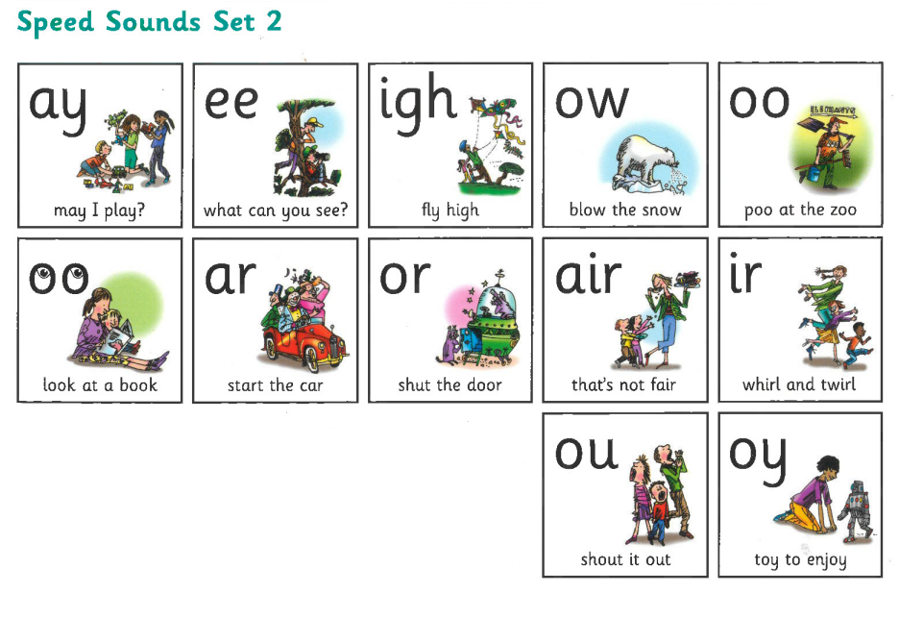
Notes:
Set 2 sounds are shaded. They are long vowel sounds with 2 or more letters. We call these ‘Special Friends’ – two letters together that make one sound.
Let’s practise saying these sounds together.
Say each sound MTYT.
Once children know these Set 2 sounds, they know one way of reading and writing every sound.

Slide 11
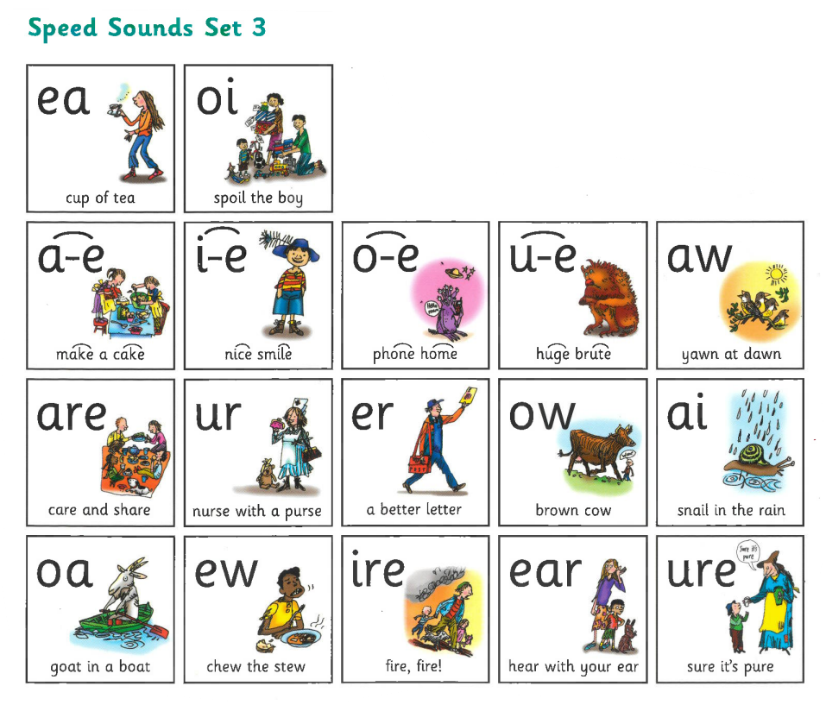

Slide 12

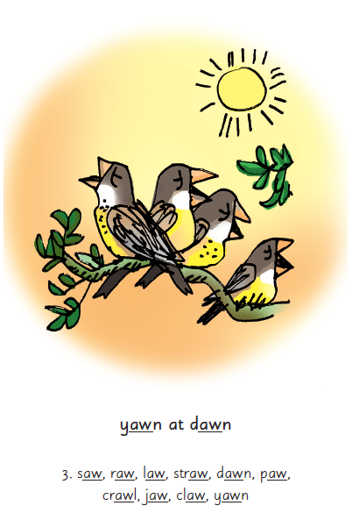
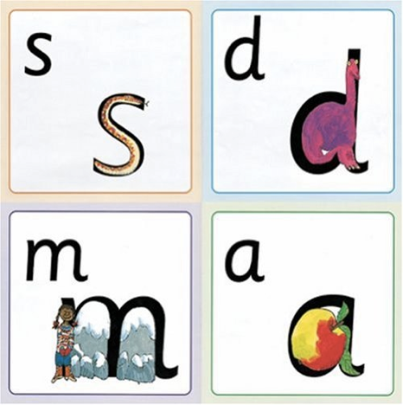
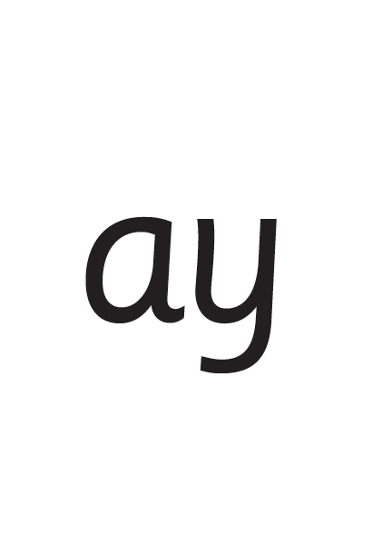
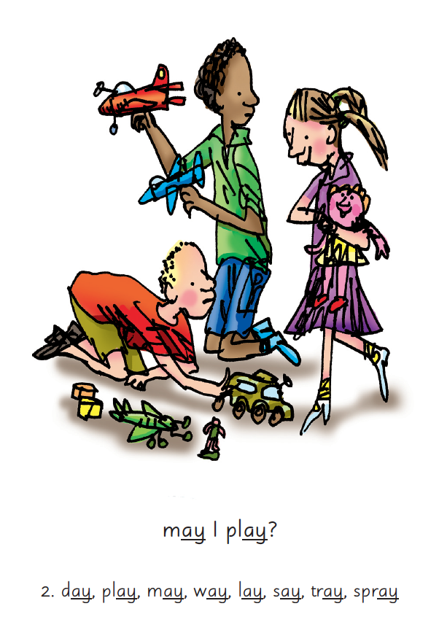
Notes:
We give children a hook to learn the sounds by using pictures in the same shape as the letter.
‘s’ looks like a snake.
We use picture phrases to help children remember the Set 2 and Set 3 sounds.
For example, ay, may I play? aw, yawn at dawn
‘d’ looks like a dinosaur.
‘m’ looks like a mountain.
‘a’ looks like an apple.
We teach the children to name the mnemonic pictures before they learn the sound.
This means that children learn to read and write the sounds really easily.

Slide 13
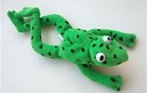


Speed sound lesson
Once the children have learnt some sounds they can start to blend them to begin to read words.
Fred the Frog helps children to learn the sounds, by helping them listen to the sounds and begin to blend the words without reading them.
Notes:
We teach children to read words using Fred Talk to blend together the sounds they know e.g. m-a-t, mat.
We say ‘Fred Talk, read the word’.

Slide 14
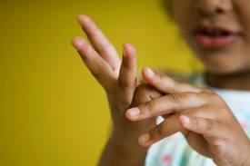
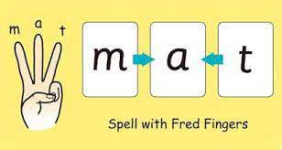
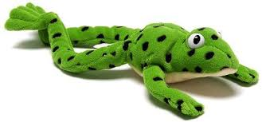
Fred fingers
Children then start to spell
words with sounds they have
already learnt.

Slide 15

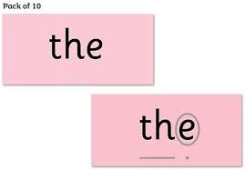
Storybook reading lessons
Children learn to read story green words, speedy green and red words from the storybook they are reading.
Green words are words which children can use Fred Talk to read the words.
Red words are tricky words which are difficult to decode.
Notes:
Some words are ‘tricky’ because they contain letters that don’t match the sounds the child has been taught.
For example, ‘said’ has ‘ai’ making an ‘e’ sound.
We teach these common exception words as Red words.
In the early Storybooks, these words are printed in red text.
Remind your child not to use Fred Talk to read Red words but instead to stop and think. Tell them the word if needed.

Slide 16
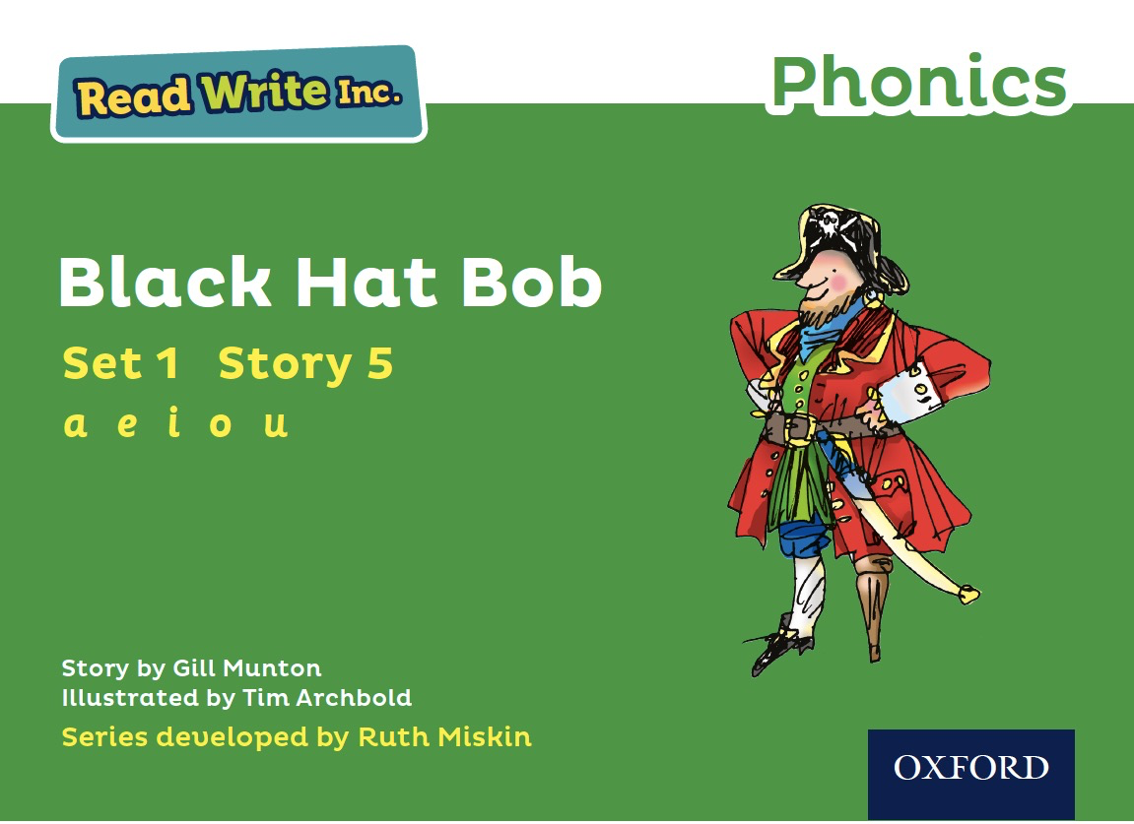
Reading the book
Children read a story book 3 times:
First read – decoding
Second read – fluency
Third read – comprehension
After the final read, the children take the book home. Children should read this more than once at home.
Reading books will be given to the child when they are ready – stage not age.
Reception children will receive a number of different reading materials before they are at the stage for one of the RWI storybooks.
Notes:
So after the third read in class, children bring the same Storybook home in their book bag.
They love this book!
They can read it like a storyteller and can’t wait to read it to you, their grandparents or even their teddy bear.
Please avoid saying, “This book is too easy for you!” but instead say “I love how well you can read this book!”
They are meant to be able to read all of the words as the book is at the correct level.
Encourage them to share their enjoyment of the story with you and read it in their storyteller voice – again and again.
In our school, children read each Read Write Inc. Storybook three times in class with their partner.
Re-reading the same book helps children to become confident readers. Each time they re-read, they build their fluency/speed and comprehension.
They love reading and want to read because they can read all of the words in the Storybook.
We set a focus for each re-read in school.
(Click) The first read focuses on reading every word accurately.
(Click) The second on reading the story more quickly.
(Click) The third read on comprehension - understanding what they read.
Then your child brings the same book home to read and enjoy with you again and again at home.
It’s ‘three with me, four at home.’
We do not send stories home the children cannot read because we always want them to be set up to succeed in their reading.
We want to make sure they enjoy reading so that they want to read.
The more they read, the faster progress they will make.

Slide 17

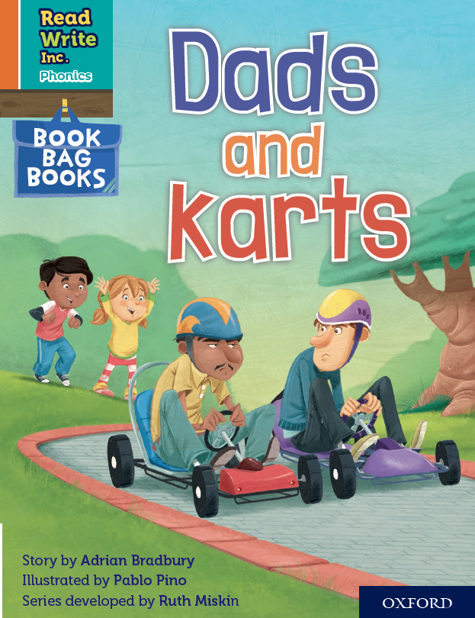

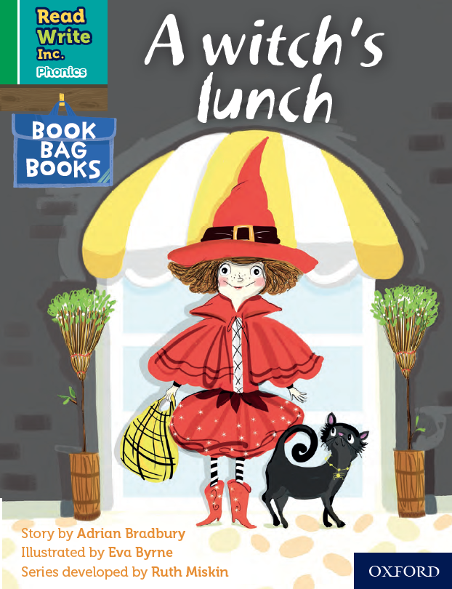
Book bag books
These books provide extra reading practice at home.
They are uniquely matched to the Read Write Inc. Phonics Storybooks.
They help to reinforce children's learning of phonics at the appropriate level.
Notes:
We use Book Bag Books especially for home reading. They have guidance inside just for you as parents.
They are matched to the books children read in school so provide practice of the same sounds – extra practice at the right level for your child.
They include many of the same reading activities that we use in class.

Slide 18
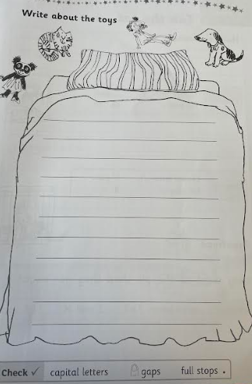
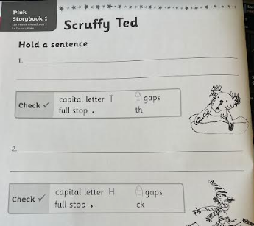
Writing activities
Notes:
Day 1 and 2 they have a go at holding a sentence. The sentence is said lots of time out loud

Slide 19
Parent Meeting
Storytimes
Notes:
Approximately 20 minutes is needed for this session.
Notes are provided to help you lead the presentation.
Notes in italics are for your attention only.
This bitesize parent session is best used alongside an assembly where the children show off a story they know well or parents join a class storytime so you can show them how to bring bedtime stories alive.
Provide copies of ‘ten top tips for reading stories to your children’ from the Portal for each parent.

Slide 20
Children who never have a story read to them, who never hear words that rhyme, who never imagine fighting with dragons or marrying a prince, have the odds overwhelmingly against them.
Maryanne Wolf
Notes:
Read quote.

Slide 21
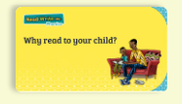
Reading to your child
https://schools.ruthmiskin.com/training/view/V2KlM3hL/ocY2Rpxa
Notes:
Day 1 and 2 they have a go at holding a sentence. The sentence is said lots of time out loud

Slide 22
10 things your child learns when you read aloud stories and poems every day
Sustain attention.
Appreciate rhythm and rhyme.
Build pictures in their minds from the words on the page.
Understand humour and irony.
Use new words and phrases in different contexts - and later in writing.
Learn new vocabulary and knowledge of the world.
Notes:
Look at all these things you child will learn when you read aloud stories and poems, - without any teaching!
Click each point and read.

Slide 23
10 things your child learns when you read aloud stories and poems every day
Think about characters’ feelings and use appropriate voices.
Follow a plot with all its twists and turns.
Understand suspense and predict what’s about to happen next.
Link sentences and ideas from one passage to the next.
Notes:
Look at all these things you child will learn when you read aloud stories and poems, - without any teaching!
Click each point and read.

Slide 24
Top Tips - Storytime
Make it a treat.
Make it a special quiet time.
Show curiosity.
Read story once without stopping.
Chat about the story.
Avoid testing with questions.
Link to other stories and experiences.
Read favourites over and over again.
Use different voices.
Love the book.
Notes:
Here are our ten top tips for Storytime at home.
Make it a treat – introduce each new book with excitement.
Make it a special quiet time – cuddle up!
Show curiosity in what you’re going to read.
Read story once without stopping so they can enjoy the whole story. . If you think your child might not understand something say something like ‘Oh I think what’s happening here is that…”
Chat about the story e.g. I wonder why he did that? Oh no, I hope she’s not going to…
Avoid asking questions to test what they remember.
Link to other stories and experiences you have shared e.g. this reminds me of…
Read favourites over and over again – encourage your child to join with the bits they know. Avoid saying ‘not that story again!’
Use different voices – be enthusiastic!
Love the book – read with enjoyment.
I will give you a handout with these tips when you leave today.

Slide 25
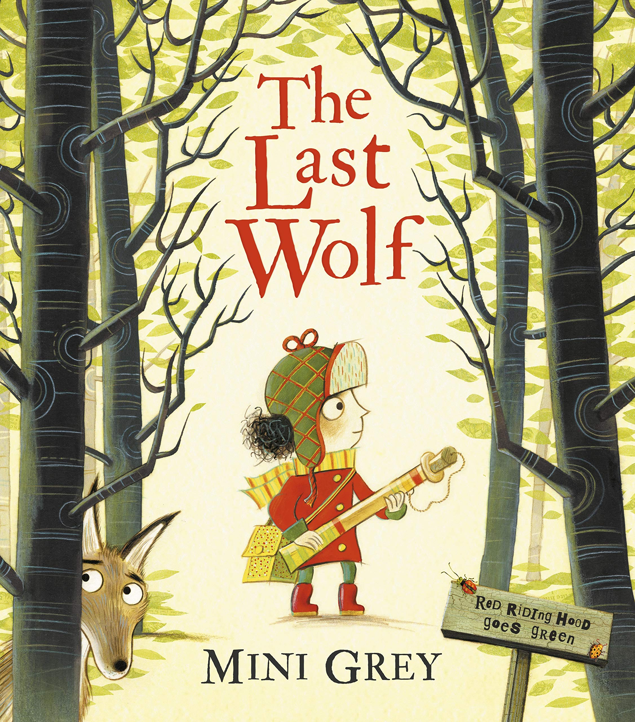

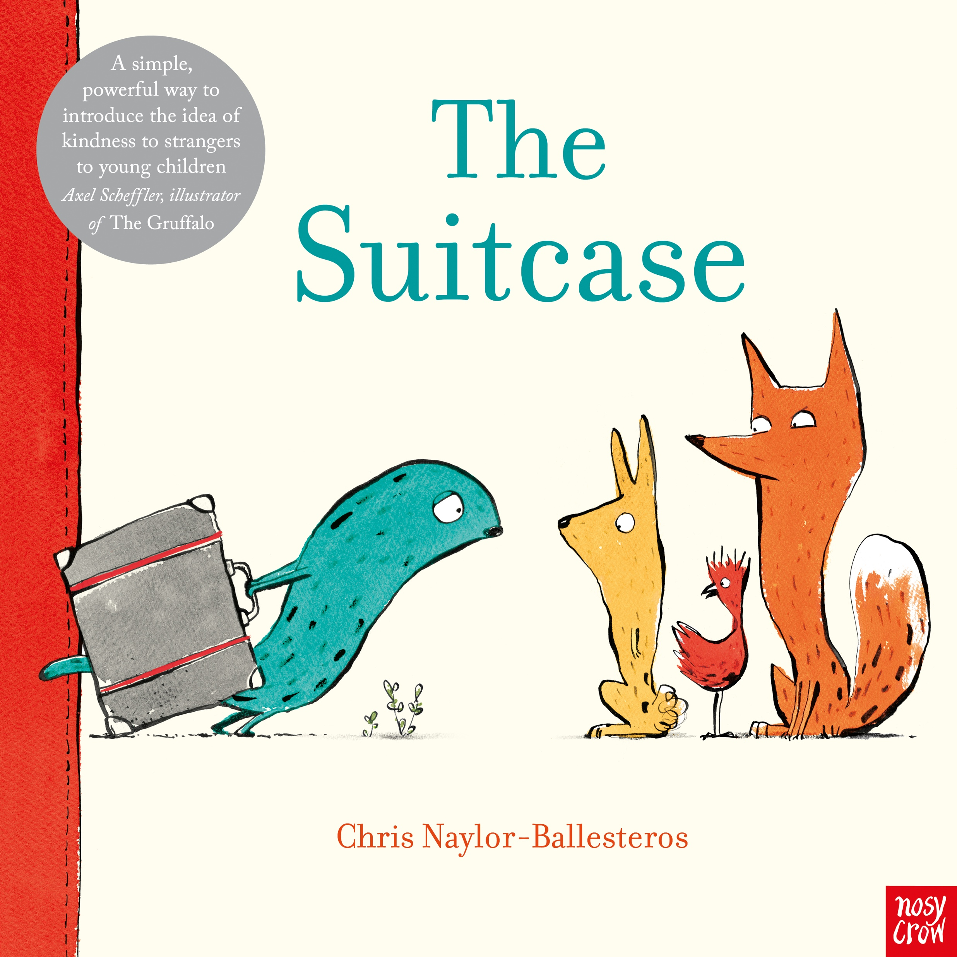
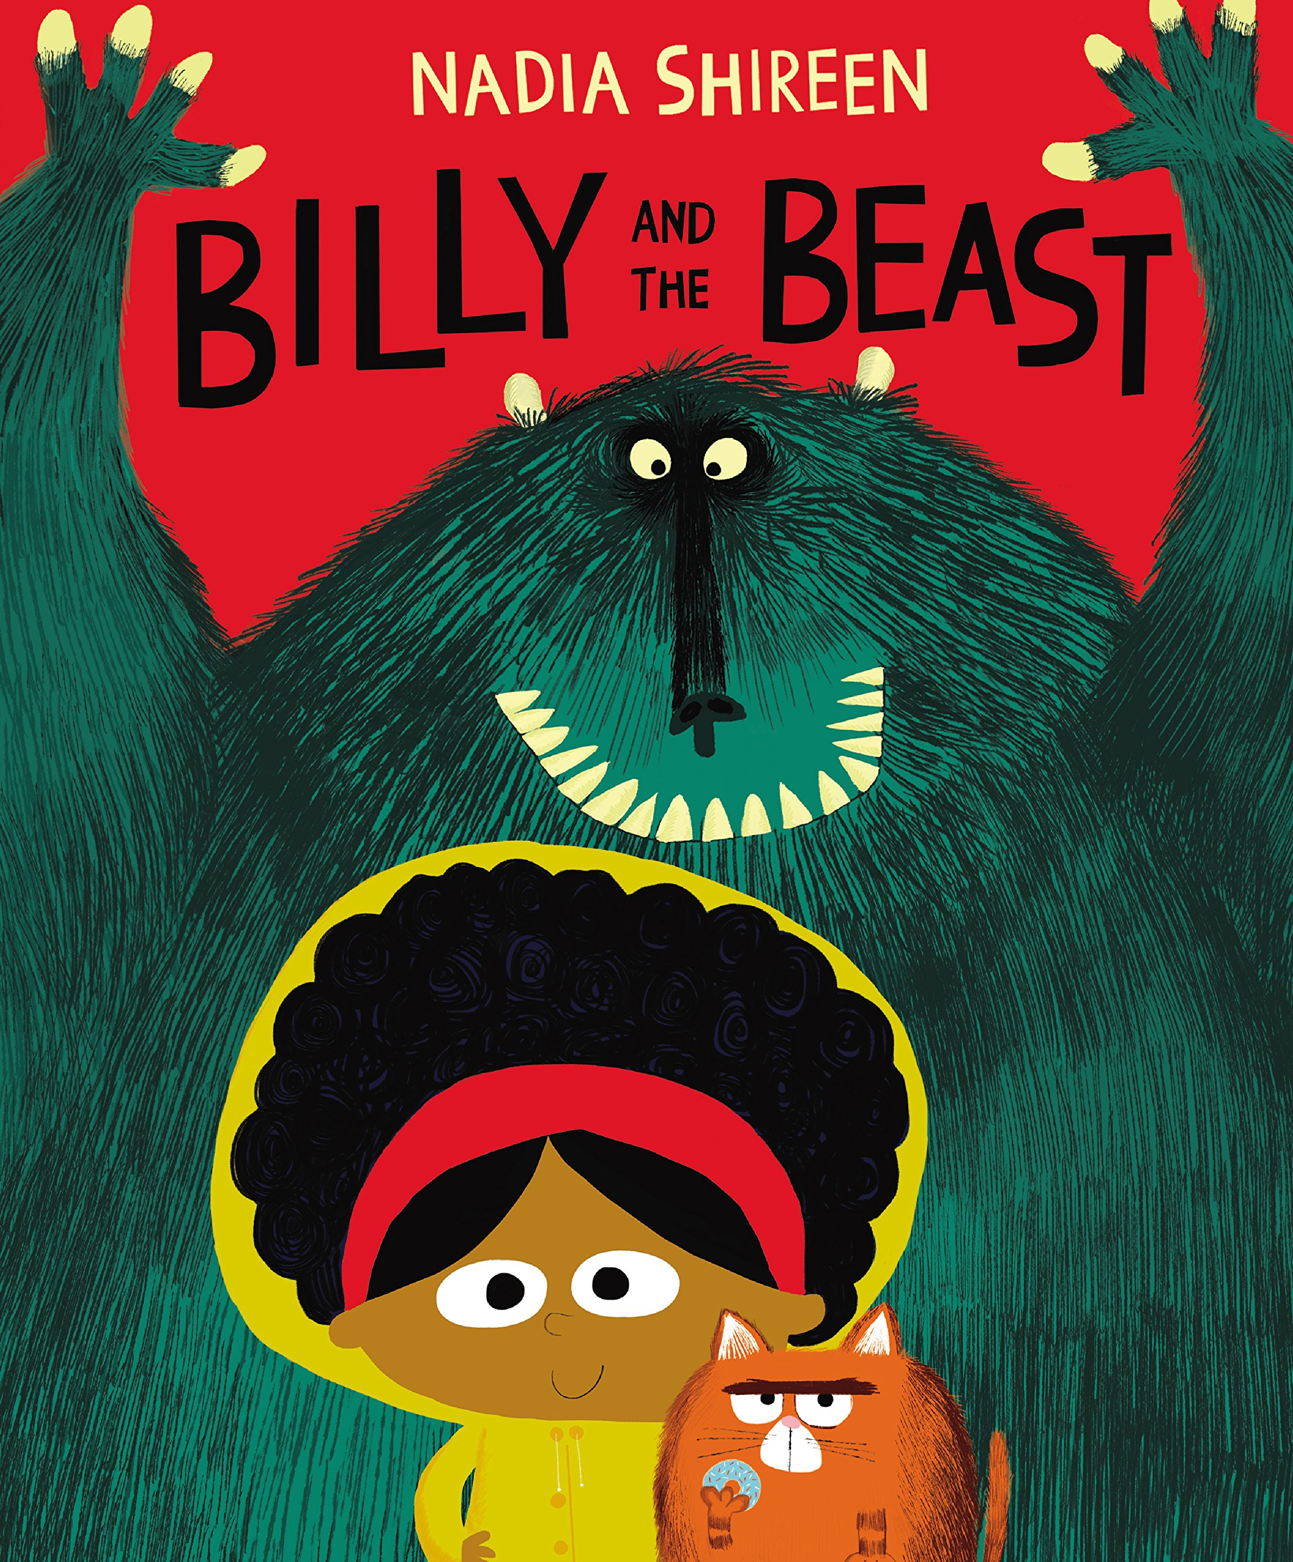
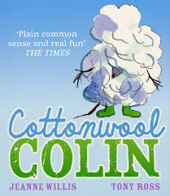
Repeated readings, Again! Again!
Children are wired to thrive on repetition.
Notes:
Stories provide a wealth of language that we don’t use in everyday talk.
The more stories, poems and nursery rhymes children know well, the more easily they will be able to understand what they read, when they can read.
Children thrive on repetition.
Take Sophie who is 2 ½ years old.
She begs for her favourite stories to be read over and over again.
The more her mum repeats the story, the more the story ‘belongs’ to Sophie.
Sophie ‘reads’ it, copying the special emphasis and actions that her mum used every time she read the story to her.

Slide 26
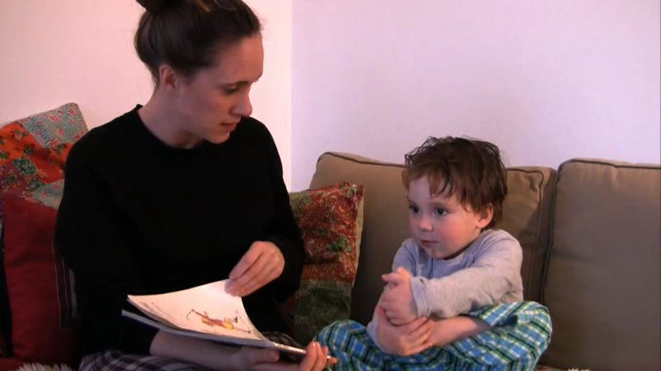
We’re Going on a Bear Hunt
Notes:
Here’s two year-old Mylo enjoying ‘We’re going on a bear hunt’ with his mum, Natalie.
Watch storytime video.
By reading stories aloud, Mylo’s mum is bonding with him through books - forming a link between reading and love.
No distractions, no technology to get in the way.
Because she loves the book, Mylo mirrors that love.
He is learning to sustain attention with his mum

Slide 27
Be a ‘talk-a-lot’ family
Talk with your child as much as possible.
Use new and ambitious vocabulary.
Build interesting sentences together.
Notes:
Research shows that the number and range of words parents use to speak to their children predicts their success at school.
Use every opportunity to talk to your child throughout the day – meal times, travelling to school, playing together etc.
Our typical spoken language tends to reuse the same words: sad, happy, nice, nasty, cross, little, big, run.
Young children soak up words incredibly quickly, much more quickly than we are able to, so don’t hold back.
As adults, we know thousands of words we can share with children – each one of us is a walking thesaurus!
Try to use a range of words and phrases with similar, but slightly different, shades of meaning (synonyms).
Encourage your children to use these words for themselves.
Build interesting sentences with your child e.g. what a miserable and gloomy day! Would you like a crunchy apple for snack?

Slide 28
What can you do?
Read the same stories aloud again and again.
Read with enthusiasm – love each story.
Talk with your child as much as possible.

Slide 29
Children are made readers on the laps of their parents.
Emilie Buchwald
Notes:
Remember that all parents have the power to change outcomes for their children.

Slide 30
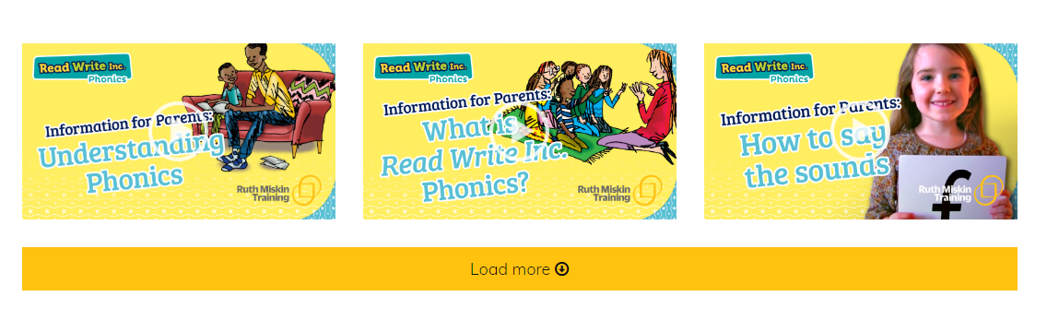
Useful websites
Ruth Miskin Parents’ Page:
http://www.ruthmiskin.com/en/parents/
Ruth Miskin Facebook:
https://www.facebook.com/miskin.education
Free e-books for home reading:
http://www.oxfordowl.co.uk/Reading/
School website
https://www.tregonycpschool.co.uk/website/phonics/470117

Slide 31

Any questions?

